Slide 1

EHS TRAINING MODULE
1

Slide 2
TITLE 1 - GENERAL SAFETY - CONTENT
DTVS EHS POLICY
    Have to show the DTVS EHS Policy, highlighting the key commitments of the organization (Safe & Healthy Workplace , Environmental Protection, 5R, Employee engagement, Continual improvement) & EHS policy requirements - what is expected from everyone (Maintaining a safe workplace, Environment impact reduction in all daily activities by 5R, Active Participation)
    Actual photographs of the EHS policy display boards placed in shop-floor locations to be shown to reinforce the culture and Purpose of display to be shown – (Daily reinforcement of safety commitment , Easy visibility and recall, Creating awareness)
SAFETY CULTURE CONCEPTS TO SHARE - Visual Representations
    Safety is everyone’s responsibility
    Safety First – Always & Our Aim - Zero Accident
    Think Before You Act
10 RULES FOR WORKPLACE SAFETY – Generic visuals & Videos
ROLES AND RESPONSIBILITIES IN SAFETY & IMPORTANCE OF SAFETY AT WORKPLACE – Generic visuals
    Follow Safety Rules and Instructions, Work Only After Proper Training and Authorization, Report Unsafe Conditions and Hazards, Report Accidents and Near Misses Immediately, Maintain Cleanliness and Housekeeping, Follow Emergency Procedures and Evacuation Plans, Cooperate in Safety Training and Toolbox Talks

Slide 3
TITLE 2 - WORKPLACE HAZARDS - CONTENT
INDUSTRIAL HAZARDS
  Definition
  Type of Industrial Hazards – Visuals
  Hazards a Comparison - At Home vs Industry
  How To Handle It - Identify → Assess → Control → Practice → Report - 5 Steps Visuals
ACCIDENTS
  Definition
  How Accidents Happening In Manufacturing & Daily Life – Common Overview
  Heinrich’s TRIANGLE
  Cause For Accidents – UNSAFE CONDITION & UNSAFE ACT

Slide 4
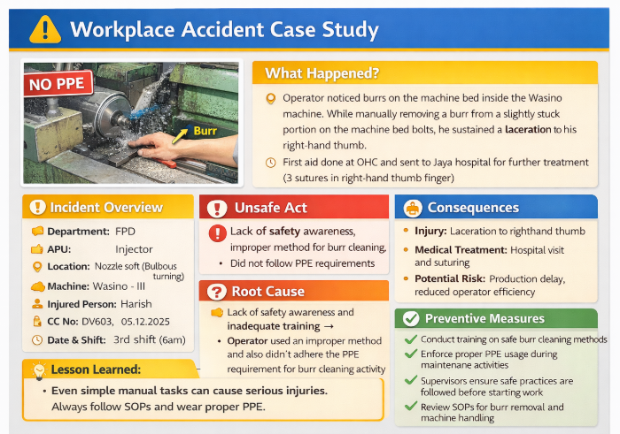
TITLE 2 - WORKPLACE HAZARDS – CONTENT ctd….
UNSAFE ACT
  Definition
  Real-life Sample video to be shown - Accidents related to unsafe conditions
  Examples - Not following Safety rules, Not following operating procedures, Operating un authorized Machines, Bypassing safety systems, Not using proper PPE, Disturbing others while working, Playing in the working areas - Visuals & Videos
  Real example of an accident happened in accident caused by an unsafe act to be shown each example (Shown below)
  Unsafe Act Audits are conducted by safety officers, line supervisors, managers, and external auditors, who observe employees and if any unsafe act is seen , actions are taken as per sop of reaction plans of USA

Slide 5
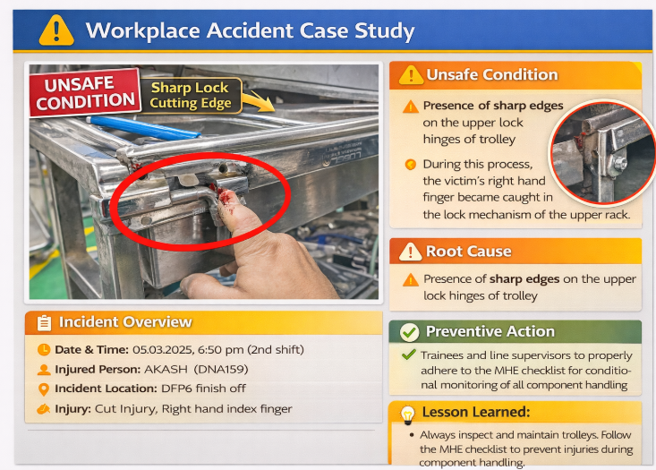
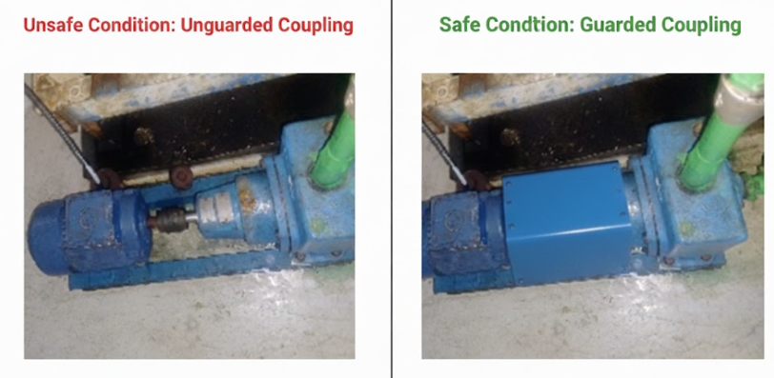
TITLE 2 - WORKPLACE HAZARDS – CONTENT ctd….
UNSAFE CONDITION
  Definition
  Real-life Sample video to be shown - Accidents related to unsafe conditions
  Examples - Unguarded Machines, Wet & Slippery floor, High Noise areas, Poor lighting & Poor Ventilation, No proper Protective Gear, Poor house keeping, Damaged electrical cables - Visuals & Videos
  Real example of an accident happened in accident caused by an unsafe condition to be shown each example (Shown below)
  Unsafe condition identified through safety FLM – Document to be shown & real photos for 4 to 5 points with explanation
  Spot the hazard picture to be shown for identification of USA & USC

Slide 6
TITLE 2 - WORKPLACE HAZARDS – CONTENT ctd….
NEARMISS INCIDENTS
  Definition
  Sample videos related to nearmiss incidents
  Real example of nearmiss incident happened in DTVS to be shown in Case study format
REPORTABLE ACCIDENT – CASE STUDY FORMAT WITH DETAILED EXPLANATION TO BE GIVEN

Slide 7
TITLE 3 MACHINE SAFETY - CONTENT
Safe Work Practices - Before Using a Machine safety FLM to be followed and abnormality reported , During Machine Operation – follow as per SOP, After Using a Machine - Switch off and isolate power if required, clean the m/c and area
Safety systems in all machines & its purpose – Full view of single machine - Visuals
  Double hand push button – Purpose & how its operating – Actual video
  Safety curtains - Purpose & how its operating – Actual video
  Interlocking system - Purpose & how its operating – Actual video
  Emergency Stop Systems - Purpose & how its operating – Actual video
  Machine Guarding – Purpose – Actual video

Slide 8
TITLE 4 PPE - CONTENT
What is PPE
PPE importance
Types of PPE and When to Use
How to Use PPE Correctly
Common Mistakes to Avoid
PPE sticker provided in all machines – Actual photographs to be shown

Slide 9
TITLE 5 EMERGENCY PREPAREDNESS& FIRE SAFETY
Emergency preparedness followed in DTVS – Basic roles and What to do
  Alarm raising
  Familiarize yourself with all exit routes and assembly points.
  Know how to quickly alert emergency services (Emergncy contact number) if needed
  Emergency Actions in Machine Areas
Fire Safety & its purpose & also DO & Donts– Actual photos
  Fire extinguisher
  Fire alarm system
  Co2 flooding

Slide 10
TITLE 6 MATERIAL HANDLING

Slide 11
TITLE 7 ELECTRICAL SAFETY

Slide 12
TITLE 8 CHEMICAL HANDLING

Slide 13
TITLE 9 SAFETY SIGNAGES

Slide 14
TITLE 10 ENVIRONMENT & SUSTAINIBILITY

